Slide 1
Object Detection – SSD

Slide 2
SSD
It stands for ‘Single Shot MultiBox Detector’.
It can create an object detector that reaches comparable accuracy to Faster R-CNN and more faster results can be obtained using smaller, more efficient base networks as well.
SSD also belongs to single-stage detector class of object detectors.

Slide 3
SSD
In single-stage detectors like SSD the convolutional layers make both predictions directly in one shot, hence the name Single Shot Detector.
Where the image is passed once through the network and the objectness score for each bounding box is predicted using logistic regression to indicate the level of overlap with the ground truth.
If the bounding box overlaps 100% with the ground truth, the objectness score is = 1 and if there is no overlap, the objectness score = 0.
We then set a threshold value (0.5) that says: “if the objectness score is above 50%, then this bounding box likely has an object of interest and we get predictions, if it is less than 50%, we ignore the prediction.”

Slide 4
SSD – Architecture
The SSD approach is based on a feed-forward convolutional network that produces a fixed-size collection of bounding boxes and scores for the presence of object class instances in those boxes, followed by a non-maximum suppression step to produce the final detections.
The architecture of the SSD model is composed of three main parts:
Base network to extract feature maps
Multi-scale feature layers
Non-maximum suppression

Slide 5
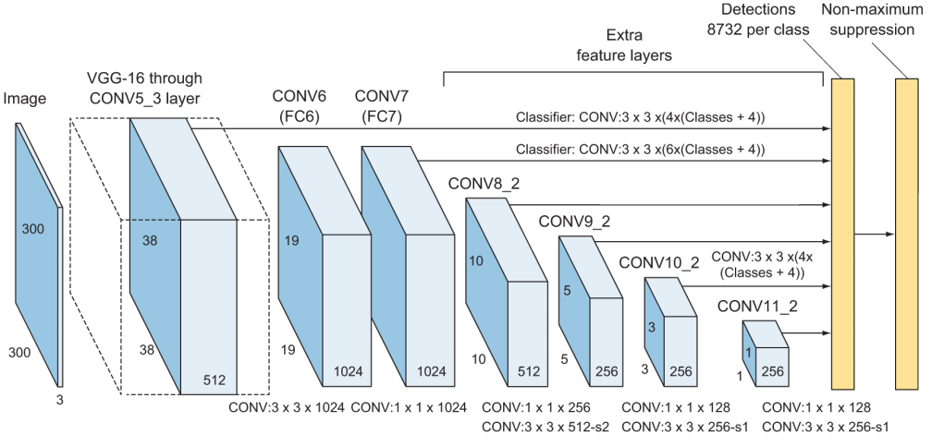
SSD – Architecture

Slide 6
SSD – Architecture
As you can see the in SSD architecture diagram, layers 4_3, 7, 8_2, 9_2, 10_2, and 11_2 make predictions directly to the Non-Maximum Suppression layer.
The fact that each feature map connects to the final layer is important — it allows the network to detect and localize objects in images at varying scales.

Slide 7
SSD – Base network
As you can see from the SSD diagram in figure, the SSD architecture builds on the VGG16 architecture after slicing off the fully connected classification layers.
The reason VGG16 was used as the base network is because of its strong performance in high quality image classification tasks and its popularity for problems where transfer learning helps in improving results.
Instead of the original VGG fully connected layers, a set of supporting convolutional layers (from conv6 onwards) were added to enable to extract features at multiple scales and progressively decrease the size of the input to each subsequent layer.

Slide 8
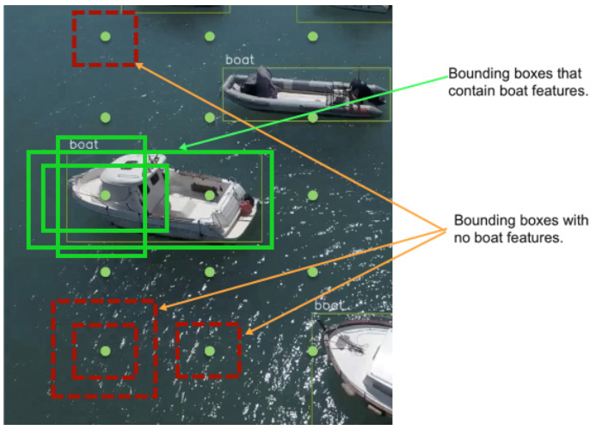
SSD – Base network
Suppose you have the image below and the network’s job is to draw bounding boxes around all the boats in the image.

Slide 9
SSD – Base network
The process goes as follows:
SSD overlays a grid of Anchors around the image and for each anchor, the network will create bounding boxes at its center.
In SSD, anchors are called Priors.
The base network looks at each bounding box as a separate image. Within each bounding box, the network will ask the question: is there a boat in this box?
In other words, it will ask: did I extract any features of a boat in this box?

Slide 10
SSD – Base network
When the network finds a bounding box that contains boat features, it sends its coordinates prediction and object classification to the non-maximum suppression layer.
Non-maximum suppression will then eliminate all the boxes except the one that overlaps the most with the ground truth bounding box.

Slide 11
SSD – Base network
A final note on the base network is that the authors here used VGG16 because of its strong performance in complex image classification tasks.
You can use other networks like the deeper VGG19 or ResNet for the base network and it should perform as good if not better in accuracy but it could be slower if you chose to implement a deeper network.
MobileNet is a good choice if you want to balance between a complex, high-performing deep network as well as being fast.

Slide 12
SSD – Multi-scale feature layers
They are convolutional feature layers that are added to the end of the truncated base network.
These layers decrease in size progressively to allow predictions of detections at multiple scales.
To understand the goal of the multi-scale features layers and why vary in size, let’s look at the horses the following image

Slide 13
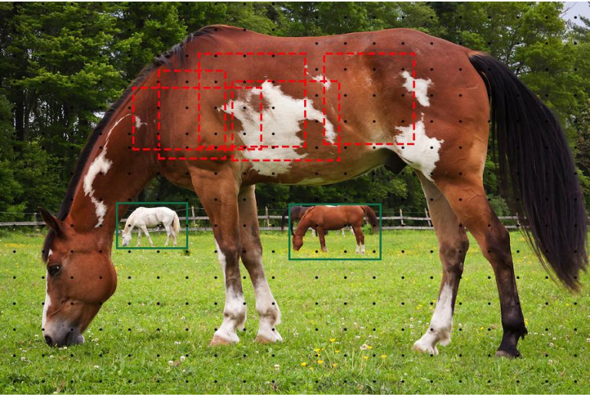
SSD – Multi-scale feature layers

Slide 14
SSD – Multi-scale feature layers
As you can see, the base network might be able to detect the horses features in the background but it might fail to detect the horse that is closest to the camera.
To deal with objects of different scales in an image, by using different convolution layers that vary in size, we can utilize feature maps from several different layers in a single network for prediction, while also sharing parameters across all object scales.

Slide 15
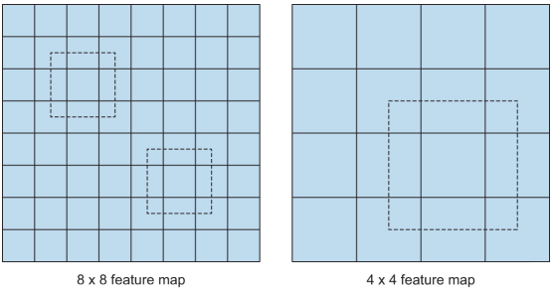
SSD – Multi-scale feature layers
As CNN reduces the spatial dimension gradually, the resolution of the feature maps also decrease.
SSD uses lower resolution layers to detect larger scale objects.
For example, the 4× 4 feature maps are used for larger scale object.

Slide 16
SSD – Non-maximum Suppression
Given the large number of boxes generated by the detection layer per class during a forward pass of SSD at inference time , it is essential to prune most of the bounding box by applying the non-maximum suppression technique.
Where boxes with a confidence loss and IoU less than a certain threshold are discarded, and only the top N predictions are kept.
This ensures only the most likely predictions are retained by the network, while the more noisier ones are removed.

Slide 17
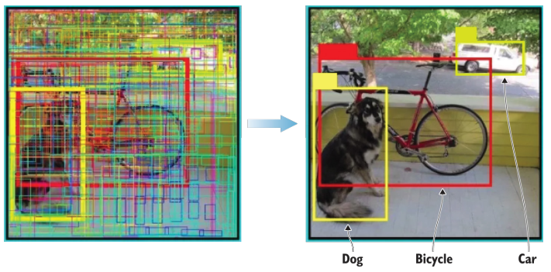
SSD – Non-maximum Suppression

Slide 18
SSD – Non-maximum Suppression
SSD sorts the predictions by the confidence scores.
Start from the top confidence prediction, SSD evaluates whether any previously predicted boundary boxes have an IoU higher than 0.45 with the current prediction for the same class (the threshold value of 0.45 is set by the authors of the original paper).
If found, the current prediction will be ignored.

